Slide 1
Chapter 8. Balanced 3 Phase Circuits

Slide 2
Section 8.1 Transformers
Contents
Ideal Transformer
  Current
  Voltage
  Impedance
  Power
Real Transformer
Application

Slide 3
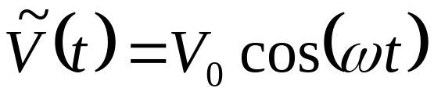
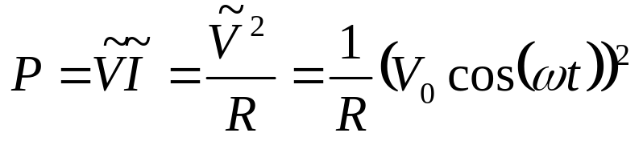
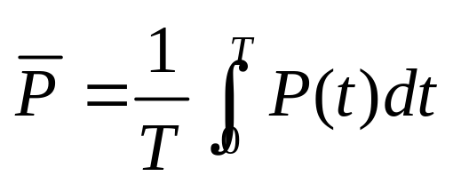
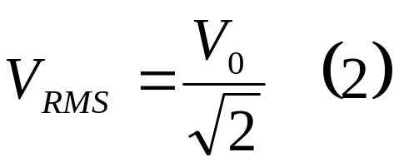
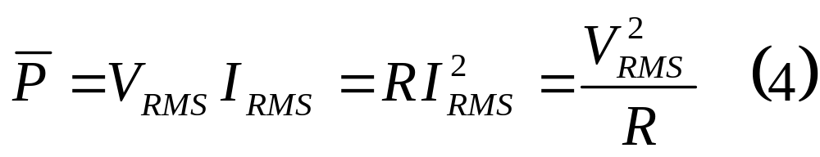
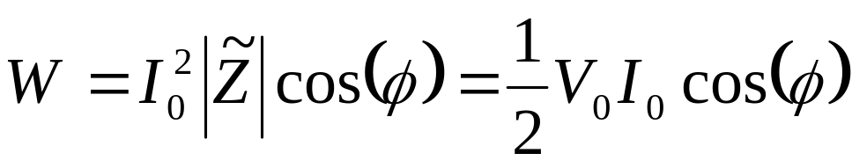
Review -Power
Power
Resistor
Dissipated Power

Slide 4


Core
Coil 1
Coil 2
Transformer consists of:
2 or more coils wound on the same core
core is a high permeability material (i.e. ) to increase the magnetic flux linkage between coils and increase mutual inductance between each pair.
consequently, when an A.C. flows in one coil, the Electromotive force (e.m.f.) induced in the other is maximised.

Slide 5
Depending on the number N of turns in the coils, the induced e.m.f. may be (>) or (<) the e.m.f. driving the transformer.
If the induced e.m.f. is applied to driving a load, power can be very efficiently passed to the load from the generator via the transformer.
i.e., the transformer (as its name indicates) provides the means for varying (or adjusting) the amplitude of an A.C. e.m.f.
Coil 1
Coil 2
Core

Slide 6
Linear circuit element: response (current & voltage) is controlled mainly by the number of turns in the coils.
These linear properties :ideal transformer model
Core
Coil 1
Coil 2

Slide 7
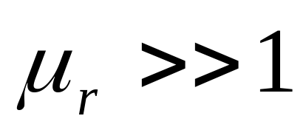
The Ideal Transformer
Perfect magnetic coupling between its coils
No energy dissipation: coils have effectively zero resistance, no ohmic (heat) loss to the core.
Coil 2
Coil 1
Core

Slide 8








Primary coil
turns
Secondary coil
turns
Fig. 1: An ideal transformer
High flux density of magnetic ( ) field lines solely within the core. Lines of have neither beginning nor end

Slide 9

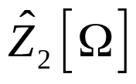
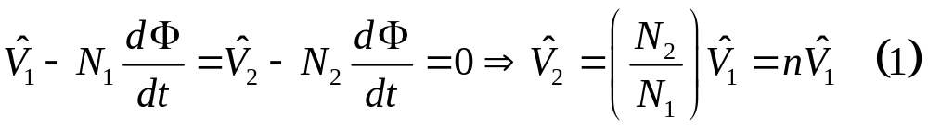
The Ideal Transformer -Voltage
Primary coil N₁ turns
Primary: an external AC source
Secondary: a load
Faraday’s Law
Secondary coil
N₂ turns

Slide 10
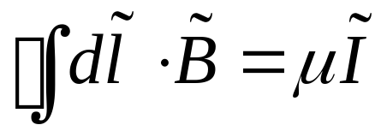
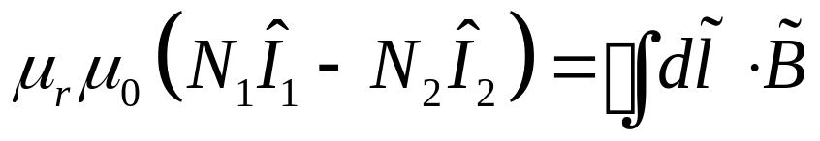
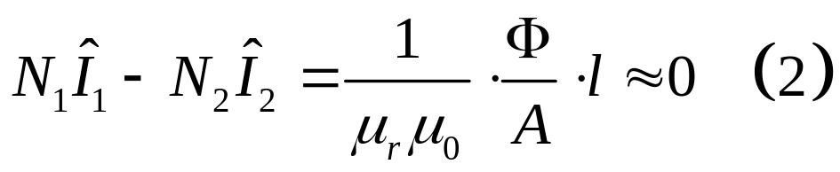
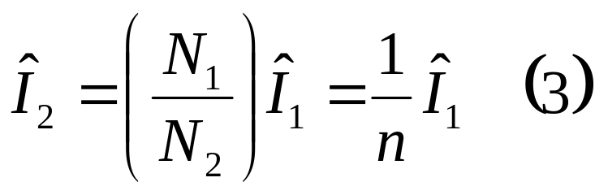
The Ideal Transformer - Current
Amperes Law

Slide 11
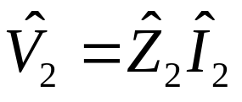
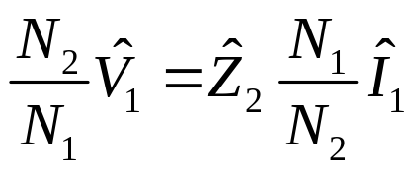
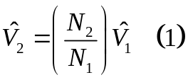
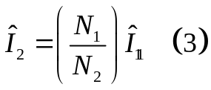
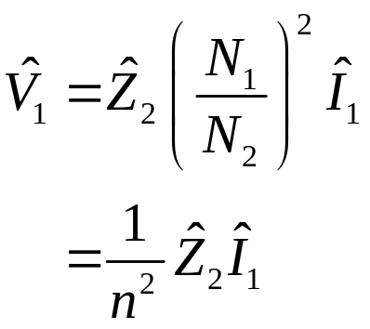
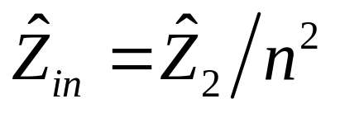
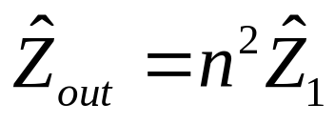
The Ideal Transformer - Impedance
Primary circuit
Output impedance

Slide 12

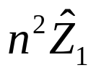

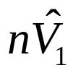

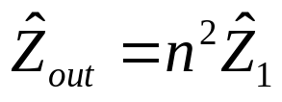
The Ideal Transformer - Impedance
Primary circuit
Secondary circuit
Figure 2
for the primary circuit – replace transformer by
for the secondary circuit – the transformer is represented by a source of e.m.f. in series with

Slide 13
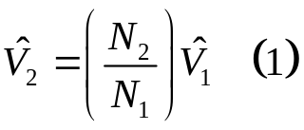

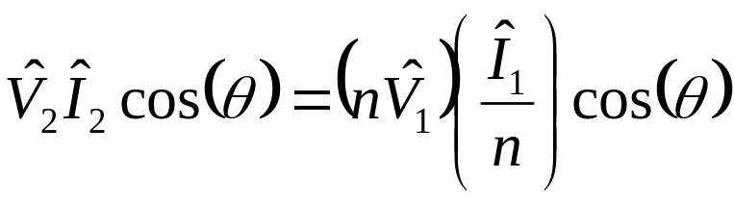
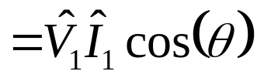

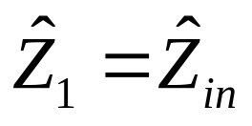
The Ideal Transformer - Power
is in phase with
is in phase with
The power factor
The power output of the secondary is:
Maximum power delivery

Slide 14
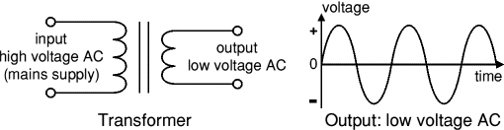
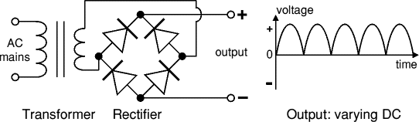
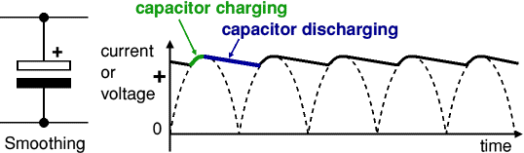
Example
A 220v to 5v, 1A DC power adapter

Slide 15
Real Transformers
None of the characteristics assumed for an ideal transformer can be achieved in practice.
A real transformer has:
    Imperfect magnetic coupling between coils (i.e. leakage flux).
    Power losses in coil windings & core
    Saturation of the core at high magnetic fields

Slide 16






Leakage Flux
The flux linkage between the coils of a transformer
The self-inductance & of the primary & secondary coils respectively, are related through their mutual inductance , i.e.
is the coupling co-efficient (the fraction of flux through one coil that threads the other).
The remaining fraction of the flux does not link the coils (and therefore does not contribute to the e.m.f. induced in the secondary).

Slide 17

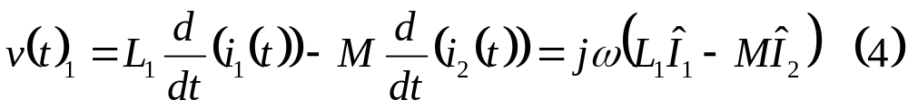
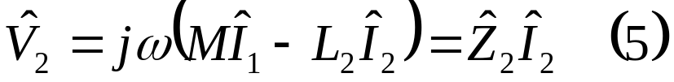
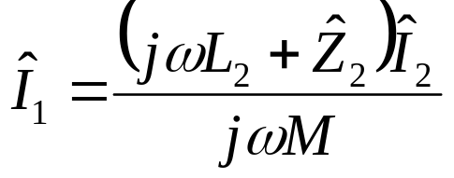
What effect does the flux leakage have?
For an angular frequency , & are
and
where the secondary is driving a load

Slide 18

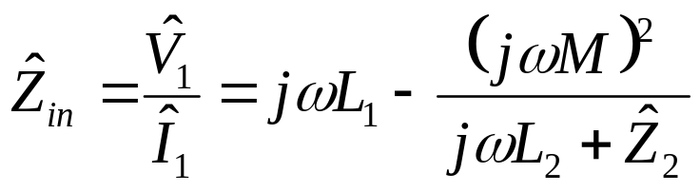
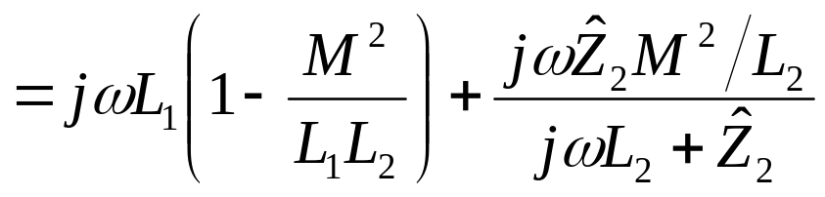
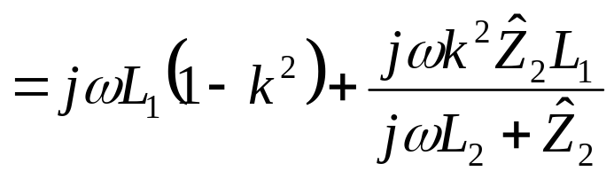
Real Transformers - Impedance
If we substitute for in equation (4), the input impedance of the transformer is given to be
2nd term

Slide 19

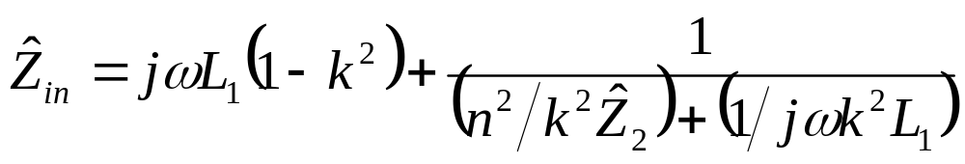


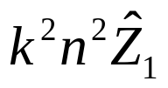
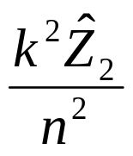




Real Transformers – Equivalent circuit
these results are summarised in the equivalent circuit of Fig. 3
Primary Circuit
Secondary Circuit
Fig.3 Equivalent circuit of transformer including leakage currents

Slide 20
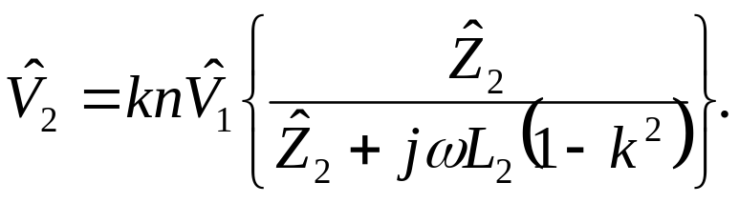
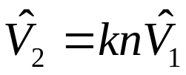
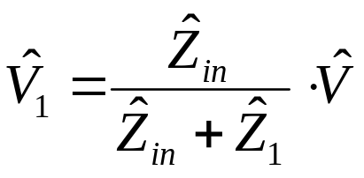
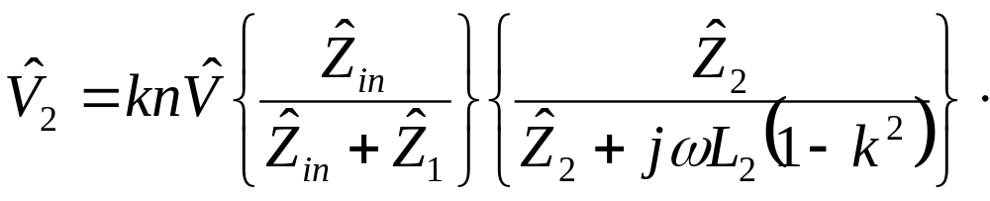
Eliminating & between equations (4) & (5) leads to the secondary voltage being:
open circuit
and

Slide 21
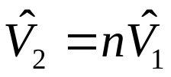
Applications of Transformers
Voltage Transformation:
electrical power is normally supplied from the mains at 220 (or 110) [V].
from , more turns are required on the secondary

Slide 22
Current Transformers:
Long distance transmission
High voltage is chosen in order to make the current as small as possible for a given power.
these transformers typically operate with efficiencies approaching that of an ideal transformer, i.e. 0.2% loss of input power.

Slide 23
Isolation Transformers:
here primary & secondary circuits may be completely isolated from each other.
In such an isolating transformer, A.C. signals can be transformed between two circuits which are at different D.C. levels.
If the coils of an ideal isolating transformer have the same number of turns, it will alter the D.C. level without affecting the A.C. signal at all.

Slide 24
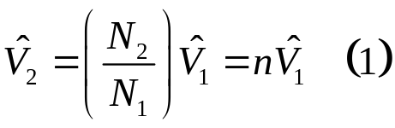
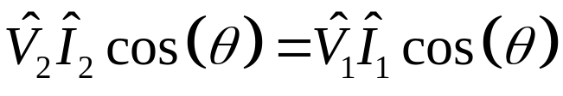
Review
Ideal transformer
Power delivered

Slide 25
Section 8.2 Three-Phase Circuits
Contents
Introduction
Winding Connection
Balanced Circuit
  Balanced Y circuit
  Balanced Δ circuit
Parallel load

Slide 26
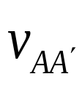
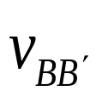
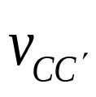
Introduction
a 3 alternator consists of a stationary stator (定子）and an anti-clockwise rotating rotor （转子） (Fig. 1).
Φ
A
Armature winding
C'
B'
rotor
Field winding
time
B
C
stator
Fig. 1a
A'
Fig. 1b

Slide 27
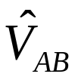








Subscript Notation:
polarities of voltages & directions of current flows are denoted by double subscripts.
therefore is the voltage drop from the reference node A to the reference node B and
similarly with . The subscripts AB identify the nodes between which the current flows. So, indicates a current flowing from node A to node B and,

Slide 28


Introduction
Fig. (1a) shows the inside surface of the stator to have three pairs of armature windings attached, with terminals AA', BB', CC‘.
3 sinusoidal voltage signals are generated in these.
the rotor has a winding that carries a current. This current established a magnetic field that cuts the armature windings as it rotates. Induction voltages are thereby created in the armature windings.

Slide 29

Introduction
a 50 Hz supply is generated by having the rotator revolve at 50 r.p.s.
the 120°phase difference between voltage peaks is achieved by physically setting the armature pairs 120°apart within the stator.

Slide 30





the voltage signals are:
where the peak voltage may be as much as 30 kV
the sum of the 3 phasors for the 3 sinusoids is 0, i.e.

Slide 31
Generator winding connections
the ends of the generator windings are joined to reduce the number of lines needed for connection to loads.

Slide 32





















Generator winding connections
two possibilities:
The primed terminal can be joined to form a Y connection (Fig. 2a) or,
primed terminals can be joined to the un-primed terminals to form a Δ (delta)
the Y-connection is preferable for alternators

Slide 33


Y-connection
line currents (currents in one of the lines of nodes A, B or C) are identical with the winding (or phase) currents.
line currents are referenced from source to load.
two sets of voltages:
  phase voltages: from the nodes (or terminal) A,B,C and N
  line-to-line voltages:

Slide 34

Y-connection
line-to-line voltages:
Voltages differ by 120°.

Slide 35


Δ-connection
Voltages:
line and phase currents:

Slide 36





Phase Sequence
the phase sequence of a 3 circuit is the order in which the voltages (or currents) peak.
Fig. 1b, peaks first, then , then etc.
This is in the permutation (or order)

Slide 37








Phase Sequence
phase-sequence can be related to the subscript of voltage & current phasors.
  if phasor leads by 120° then the voltage leads by 120°, implies the phasor-sequence ABC
  ABCABCABC
Fig. 3a
Fig. 3b

Slide 38




Balanced Y-Circuit
Fig. 4
Y-connected alternator
Y-connected identical loads
Balanced
Alternator with Y-connected windings + balanced Y-load
3-phase circuit is simplified as 3 inter-connected circuits with phase difference of 120°

Slide 39





Balanced Y-Circuit
Angle Relationships
A balanced Y-load, relative phase angle between a line voltage and its associated phase voltage 30º
lead or lag depending on the particular set of voltage lines being considered and the phase sequence
Fig. 3a

Slide 40





Balanced Y-Circuit
if 1 line current is determined then the others can be found from:
Balanced Y-circuit
from KCL
N-line (wire) carries no current, so it could be removed to leave a 3-line circuit
Usually is kept in case of unbalance load

Slide 41



Magnitude relations in Balanced Y-Circuit
a balanced Y-load, the magnitude of the line voltage is times greater than that of the phase-voltage
3

Slide 42
Example
220v AC with 50Hz
  3 Phases?
  Line Voltage?
  Phase Voltage?

Slide 43






Balanced Δ-load
Alternator (3 -source)
Voltage
Phase currents

Slide 44




Balanced Δ-load
apply KCL
Alternator (3 -source)
the same form as the phase & line voltages of a Y-balanced load

Slide 45


Δ-Y Transformation
Z_{Y}
Z_{Y}
Z_{Y}

Slide 46

Example
A balanced three-phase Y-connected generator with positive sequence has an impedance of 0.2 + j0.5 Ω /φ and an internal voltage of 120 V/φ. It feeds a Δ-connected load through a distribution line having an impedance of 0.3 + j0.9Ω /φ. The load impedance is 118.5 + j85.8 Ω /φ. Use the a-phase internal voltage of the generator as the reference.
a) Calculate the line currents IaA, IbB, and IcC .
b) Calculate the phase voltages at the load terminals.
c) Calculate the phase currents of the load.
d) Calculate the line voltages at the source terminals.

Slide 47




Example
The a-phase line current is
Z_{Y}
Z_{Y}
Z_{Y}

Slide 48



Example
The phase voltage is
Phase current
Z_{Y}
Z_{Y}
N
Z_{Y}

Slide 49







Example
Line voltages at the source terminals
Z_{Y}
Z_{Y}
Z_{Y}

